Slide 1





Leveraging Historical Data to Guide India’s Entry into the Anime Industry

Slide 2

Crafting Dreams, One Frame at a Time.

Slide 3

TABLE OF CONTENTS
1.
Problem Statement
2.
Objective
3.
Data Model
4.
Dashboard Showcase
5.
Insights
6. Recommendation

Slide 4



Problem Statement
As global demand for anime continues to surge, Nirmaan Animations, an Indian anime studio, has a significant opportunity to establish its presence in this lucrative market.
The studio faces a lack of localized knowledge in producing anime that appeals to international audiences. This project will utilize historical data from established anime sources to identify trends and success factors that will inform Nirmaan Animations' production strategies.

Slide 5
Objective
The objective of this project is to analyze historical anime data to identify key factors influencing anime popularity and success. This analysis will guide Nirmaan Animations in making informed decisions about genres, themes, production strategies, and release schedules.

Slide 6
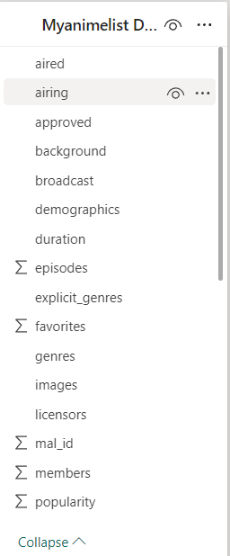
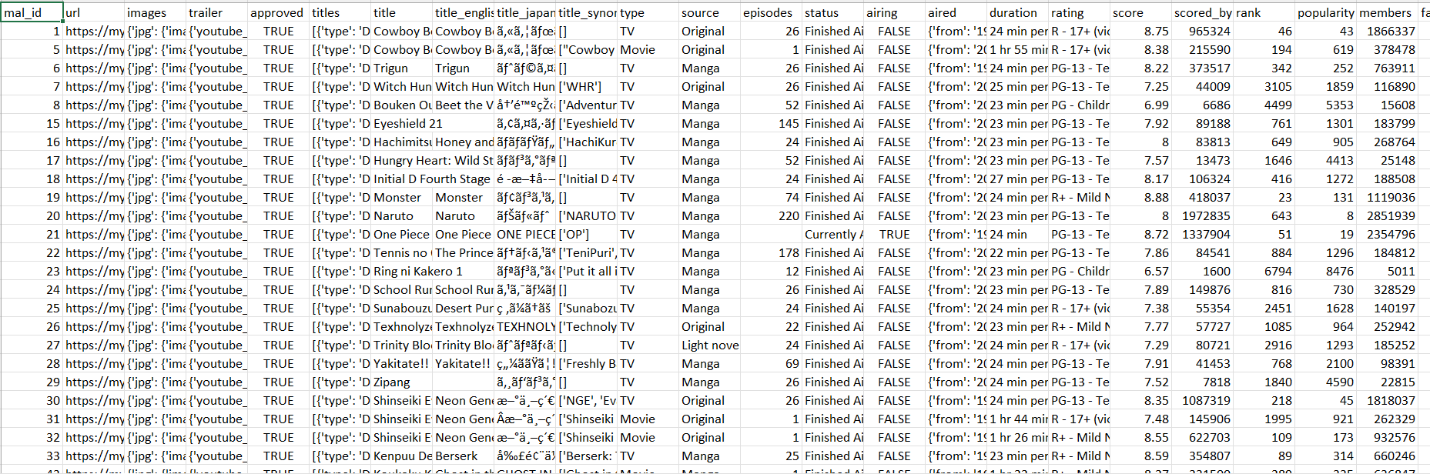
Data Model
Data Model
This dataset is a comprehensive collection of anime data fetched from the MyAnimeList website using the Jikan API. It includes information on the latest animes, making it a valuable resource for up-to-date recommendations.
it contains 36 columns and 26722 rows

Slide 7
Dashboard Showcase
https://app.powerbi.com/view?r=eyJrIjoiYTY0ZWQ5YjItZWNlNS00NzNkLWJiYjgtY2IwNzBkMmRlYjRlIiwidCI6IjM4ZjYyOTI2LTc1NTktNGFlZi04NGFlLWNiNWUxNzI0MDZmYiJ9&pageName=9f92274749a760dd7086

Slide 8
Insights

Slide 9
1.General Analysis
1- Cultural Shifts and Mainstream Acceptance
Anime has transitioned from a niche interest to a mainstream cultural phenomenon, particularly among younger audiences like Gen Z, contributing to the rise in average ratings.
2-The emergence of Frieren as the highest-rated anime indicates a shift in viewer preferences towards narratives that blend emotional depth with fantasy elements. This trend suggests that audiences are increasingly valuing storytelling that explores character development and existential themes
2.Genre Analysis
1- Action's Dominance: Action remains the most popular genre across all seasons, indicating its enduring appeal and broad audience reach.
2- Fantasy's Rise: Fantasy has emerged as a strong contender, beating action thrice in the last five years. This trend suggests that viewers are increasingly drawn to immersive worlds and epic storytelling.

Slide 10
3.Studio Analysis
1- Mappa and Wit studio both are in top 10 most popular anime studios with just around 100 anime releases compared to other top 10 anime studio average release which is around 250.
They generally focus on adapting well-known manga or light novels with established fanbases.
2- Despite not having the backing of the "Big 3" franchises (Naruto, One Piece, and Bleach) and with just one anime from the top 10 most popular anime, A1 Pictures has emerged as the most popular anime studio.
4.Age rating Analysis
1- While PG-13 content dominates the anime market with the highest number of releases (9,481), R-17+ content has achieved the second-highest popularity despite having nearly 10 times fewer releases (1,519). Also, the high average rating of 6.97 for R-17+ anime suggests that well-crafted, mature stories and characters can resonate strongly with their target audience
2. Hentai has the second lowest average rating (6.13) and least popularity (11 million). This suggests that explicit content may not be as well-received or widely accepted as other age ratings.

Slide 11
5.Release Schedule
1- Sundays are the most popular day for anime releases, with a significant drop in the number of releases after Fridays.
2- April has the most members (240 million), followed by October (234 million), and then July (188 million). This suggests that these months are peak seasons for anime releases, with a significant drop in popularity with December (32 million) at 5th place and lower for all other months . least popular is May (14 million).

Slide 12
Recommendations

Slide 13
1.General Analysis
1-Develop Emotionally Resonant Narratives- Given the shift towards narratives that blend emotional depth with fantasy elements,
Frieren being a good example to learn from , Nirmana Animations should focus on creating anime that emphasizes emotional depth and character development.
2- Engage with the Gen Z Audience- As anime's popularity grows among younger audiences, Nirmana should tailor its marketing to connect with Gen Z. This includes leveraging TikTok, Instagram, and Twitter for behind-the-scenes content, character spotlights, and interactive campaigns like cosplay events that encourage engagement.
2.Genre Analysis
1- Capitalize on Action Genre's Popularity
Since action is consistently the most popular genre across all seasons, Nirmana should prioritize developing high-quality action-oriented anime series.
2- Blend Action with Fantasy and Supernatural Elements -
Given the popularity of action ,fantasy and the high ratings of fantasy and supernatural genres, Nirmana should explore blending these elements in their anime series.

Slide 14
3.Studio Analysis
1-Focus on Quality over Quantity: Rather than aiming to match the release numbers of studios like Toei Animation, Nirmana should prioritize producing a smaller number of high-quality, well-received anime series that can build its reputation and popularity among fans.
2- Prioritize Adaptations of Popular Source Material: Following the success of MAPPA and Wit Studio's Attack on Titan adaptations, Nirmana should consider acquiring the rights to adapt well-known manga or light novels with established fanbases.
3- Diversify Content: The most popular studio, A1 Pictures, has released anime across various genres, from supernatural series like "Black Butler" to psychological-romance anime like "Kaguya-sama: Love is War." This diversity in content allows the studio to cater to different audience preferences and maintain a strong reputation.
4.Age rating Analysis
1- Focus on Mature Content: Given the highest average rating and popularity of R-17+ content i.e 2nd most popular even though having almost 10 times less anime than pg-13 which is first, Nirmana Animations should consider producing mature content that is well-received by audiences. This can include psychological thrillers, dramas, or other genres that cater to a mature audience.
2- Avoid Hentai Content: Given the low average rating and number of releases for hentai content, Nirmana Animations should avoid producing explicit content that may not be well-received by audiences.

Slide 15
5.Release Schedule
1- The studio should aim to release anime on popular days like Sundays, Saturdays, and Fridays, which have the highest number of members.
2- Nirmana Animations should plan their releases strategically, focusing on peak months like April and October, and avoiding low-popularity months like December and May.

Slide 16












THANK YOU

